Slide 1

Repeat Visit Modeling in E-Commerce
Ashish Chandra Jha

Slide 2
Project Pipeline
Planned
3 Days
1 Week
2 Week
2 Week
1 Week
Business Understanding
Data Understanding
Repeat Visit Modeling
Evaluation
Data preparation
Actual
3 Days
1 Week
6 Week
2 Week
1 Week

Slide 3
Process
Business Understanding
Data Understanding
Data Preparation
Repeat Visit Modeling
Evaluation

Slide 4
Business Understanding
Companies Background:
ABC is a fashion category multinational company with a turnover of more then one billion dollars. It has 40 factories across the globe.
ABC is a profitable company which makes money using their E-commerce website and few other marketplace like Amazon and Flipkart.
ABC products are sold through online and offline channels both company owned and with partners.
Their clients includes - Victoria’s Secrets, Marks & Spencer, Triumph, Speedo, Calvin Klein among others.

Slide 5
Business Understanding
Business found that customers with a fixed tenure shopping pattern has not bought any product for sometime, which is a cause of concern
They are looking to identify the customers who has already churned or likely to churn
Repeat visit purchase modeling technique is used to understand the demographics of those customers and try to regaining them by giving some recommendation (future work)

Slide 6
Data Understanding
The dataset contain one year sales data from Jan-Dec 2019.
Data contains :
35 features, which are - Order No, External Order No, Order Date, Order Type, Status, Customer Name, Country, State, City, Email, SKU Code, Style, SKU Desc, Category1, Sub Category, Size, Color, Type, Quantity, Return Qty, Order Currency, Price, Ship Cost, Packing Cost, Discount, Discount Code, Tax, Invoiced, COGS, Invoiced In Base Currency, Gross Margin, GM Percent, Primary Vendor, On Hold Status and Replacement Order

Slide 7
Data Understanding
Few important features in the data are Order number, Order Date, City, SKU Code, Size, Color, Quantity, Invoiced, Gross Margin
Feature Description:
Order number : Auto generated Order number in order management system
Order Date :- Exact time of the order
City :- Order placing city
SKU Code :- The SKU code (product code) ordered by the customer
Size :- Product Size
Color :- color name given by the designer
Quantity :- Qty ordered per SKU
Invoiced :- invoiced to the customer
Gross Margin :- percentage of profit made on invoiced amount

Slide 8
Data Preparation
For any business, data preparation is the most important step as it improves the data quality and increases the overall productivity
Below are the few techniques which has been used for the data cleaning :
Creating Unique Order No. :- Dataset contain multiple Order number for same product purchase (as it’s taking one row for every unit purchase) Solution to this is creating a new order number by matching Order No and SKU Code
Removing Outlier:- Based on Invoiced amount removed the outlier (these are retailer. Will treat them separately)

Slide 9
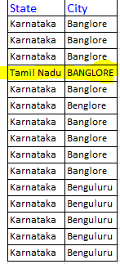
Data Preparation
Huge amount of time has been spent on cleaning the city. Prominent issues with the city columns are:-
Similar names for same city. E.g. Bangalore , Bengaluru
Whole address or just the pin code in city column
Some cities like Bangalore is tagged to Tamil Nadu, Delhi etc.

Slide 10
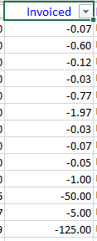
Data Preparation
Invoiced feature has some negative values
Upon check with business, we found that these are few dissatisfied customer who has been rewarded with free gift items.
Removing negative value from invoiced has been suggested.

Slide 11
Exploratory Data Analysis
Exploratory Data Analysis is used to analyze the data sets to summarize their main characteristics, often with visual methods like graphs and lists.
Below are the outcome from EDA :

Slide 12
Exploratory Data Analysis

Slide 13
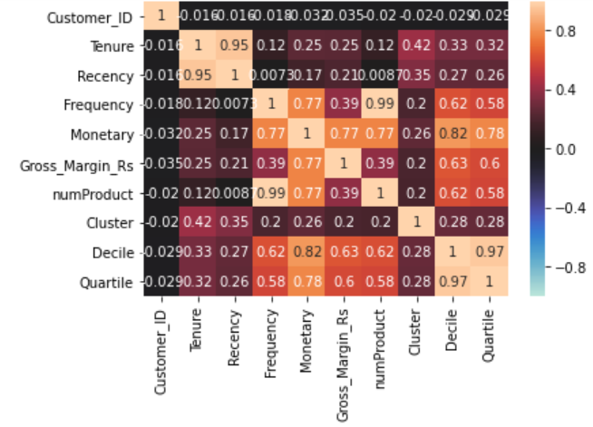
EDA – Correlation Matrix

Slide 14
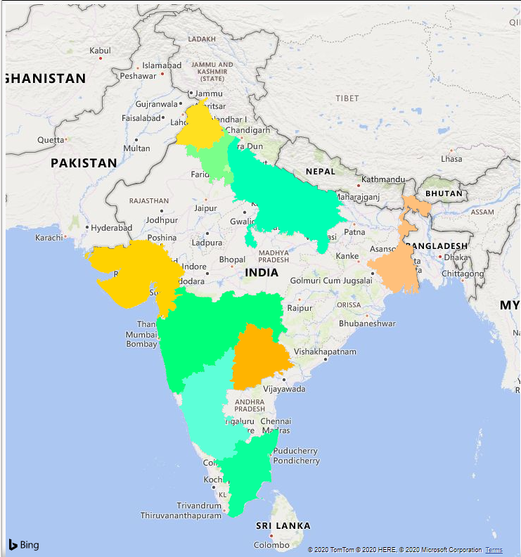
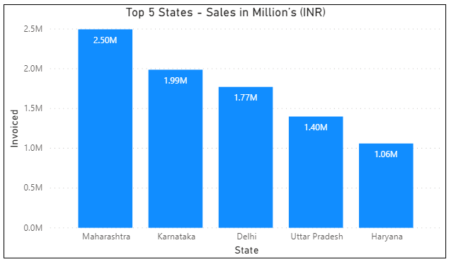
EDA – Top 5 State Sales

Slide 15
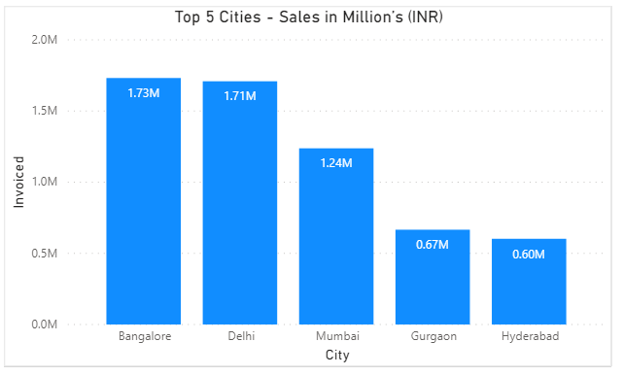
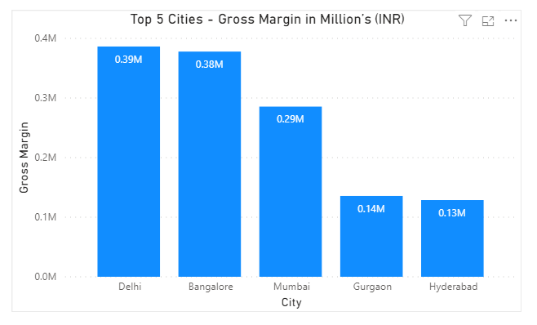
EDA – Top 5 Cities Sales & GM

Slide 16
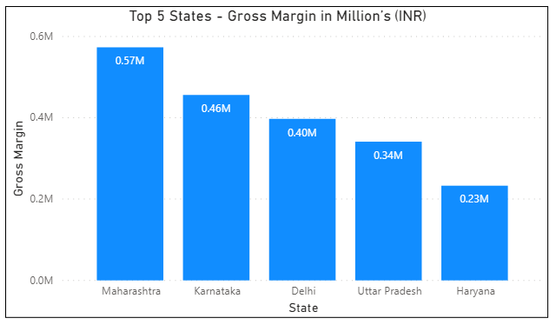
EDA – Top 5 Cities Gross Margin

Slide 17
EDA – Top 5 Cities Gross Margin

Slide 18
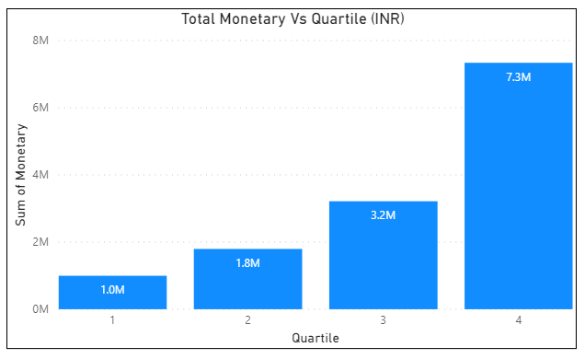
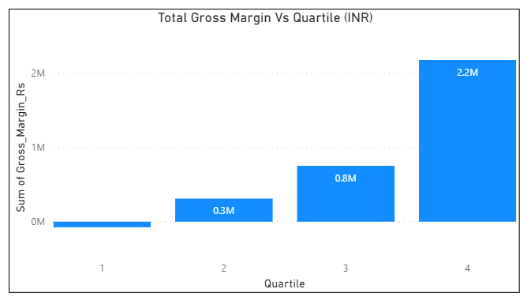
EDA – Monetary & GM Quartile wise

Slide 19
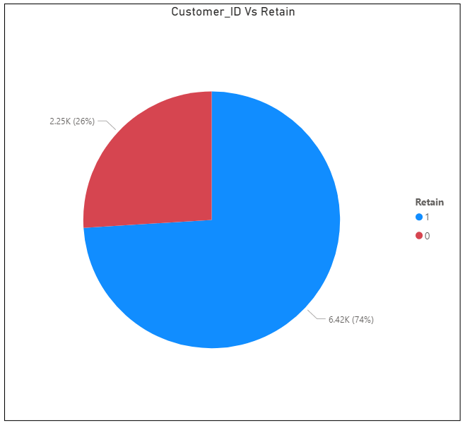
EDA – Customers Retain/Lost

Slide 20
Repeat Visit Modeling

Slide 21
Repeat Visit Modeling
Repeat Visit Modeling is a modeling technique where algorithm predicts which customers are likely to visit or going to be churned.
Used 1 year cleaned and clustered data (Jan 2019 – Dec 2019) for analysis
Used three modeling technique (KNN, Decision Tree, Random Forest) for sales forecasting

Slide 22
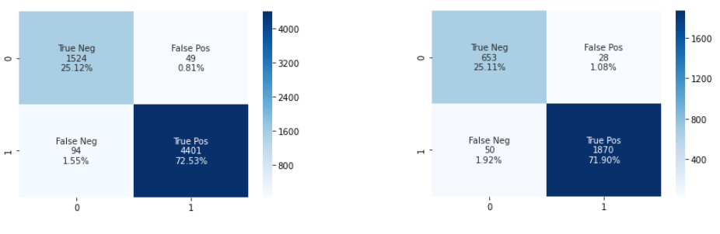
Repeat Visit Modeling - KNN
Training Accuracy Score – 97.64%
Test Accuracy Score – 97.00%
Confusion Matrix- Training
Confusion Matrix- Test

Slide 23
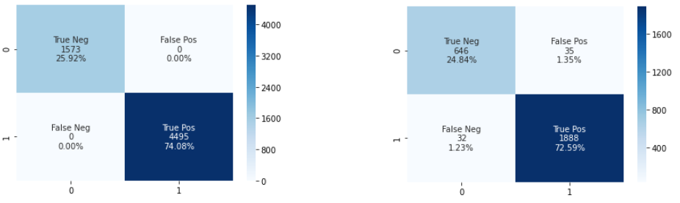
Repeat Visit Modeling - Decision Tree
Training Accuracy Score – 100%
Test Accuracy Score – 97.42%
Confusion Matrix- Training
Confusion Matrix- Test

Slide 24
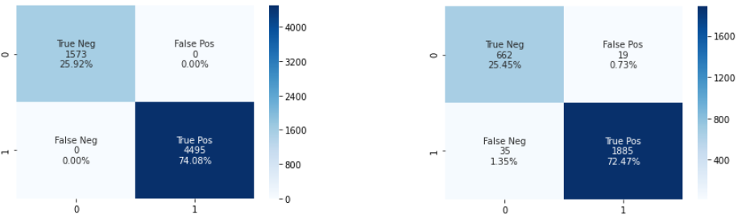
Repeat Visit Modeling - Random Forest
Training Accuracy Score – 100%
Test Accuracy Score – 97.92%
Confusion Matrix- Training
Confusion Matrix- Test

Slide 25
Evaluation
For Repeat Visit Modeling, we have used three modeling techniques namely KNN, Decision Tree, Random Forest to identify the customers who are likely to come or not
Started the modeling with KNN followed by Decision Tress and Random Forest
Using accuracy score and confusion matrix , all three models has been evaluated on train and test data, Random forest is able to predict the retained customers more accurately

Slide 26
Special Thanks to Dr. J.B.Simha and Dr. Shinu Abhi for guidance Sanjeev Kumar Jha for collaborative work support

